Slide 1
UML: Introduction

Slide 2
Topics covered in this Session
1. Introducing UML.
2. What constitutes the UML.
3. Concepts of UML.

Slide 3
What is UML?
Is a language. It is not simply a notation for drawing diagrams, but a complete language for capturing knowledge(semantics) about a subject and expressing knowledge(syntax) regarding the subject for the purpose of communication.
Applies to modeling and systems. Modeling involves a focus on understanding a subject (system) and capturing and being able to communicated in this knowledge.
It is the result of unifying the information systems and technology industry’s best engineering practices (principals, techniques, methods and tools).

Slide 4
Unified Modeling Language (UML)
Version 1.1 was adopted in November 1997 by the Object Management Group (OMG) as a standard language for object-oriented analysis and design
Initially based on a combination of the Booch, OMT (Object Modeling Technique): Jim Rumbaugh and OOSE (Object-Oriented Software Engineering): Ivar Jacobson methods
UML was refined and extended by a consortium of several companies, and is undergoing minor revisions by the OMG Revision Task Force.

Slide 5
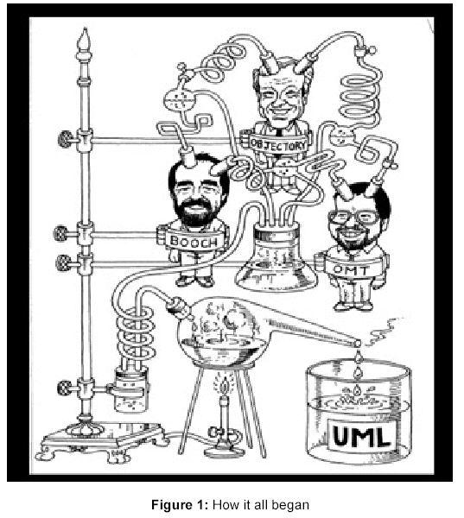

Slide 6
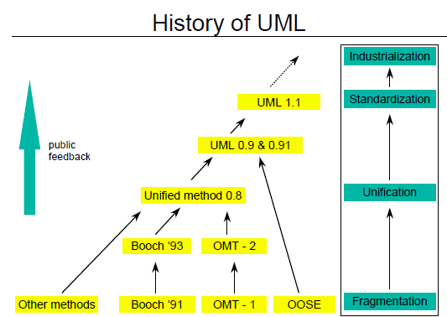
The Unified Modeling Language.

Slide 7
UML Diagrams
UML includes diagrams for
use cases
static structures (class and object diagrams)
behavior (state-chart, activity, sequence and collaboration diagrams)
implementation (component and deployment diagrams).
For data modeling purposes UML uses class diagrams, to which constraints in a textual language may be added

Slide 8
The UML process
There are four kinds of things in the UML.
1. Structural Things.
2. Behavioral Things.
3. Grouping Things.
4. Annotational Things.

Slide 9
Things in UML
Structural Things
Behavioral Things
Grouping Things
Annotational Things
1. Class
1. Interaction
1. Packages
1. Notes
2. Interface
2. State Mechanism
3. Collaboration
4. Use Case
5. Active Class
6. Components
7. Nodes

Slide 10
Structural Modeling: Core Elements

Slide 11
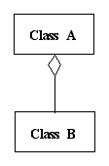
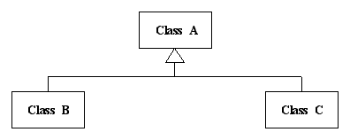
Structural Modeling: Core Relationships

Slide 12
Static Structure
Class : shows classes & relationships
Class name
attribute
attribute:primitiveDataType or Class
attribute: type or Class=default value
method
method ( )
method (argument_list):type or Class
Attributes
- (private)
# (protected)
+ (public)
Class name
Methods
- (private)
# (protected)
+ (public)
Text that describes what the object has to do
<<Responsibilities>>
Basic UML notation for classes
Notes:
~ Package
/ Derived
underline Static

Slide 13
Class Relationships in UML
Generalization
Dependency
Association
realization (interface)
instanceOf
refines
<<instanceOf>>
<<refines>>

Slide 14
Association
Structural relationship between peer classes (or objects).
Association can have a name and direction, or be bi-directional
Role names for each end of the association
Multiplicity of the relationship

Slide 15
Associations
Associations document relations between two or more classes
Association name
Class A
Class B
role_A
role_B
Contains
Order
lineNumber:int
Part
orderNumber:int
made_up_of
included_in

Slide 16
Multiplicity of Associations
Multiplicity: refers to how many objects of one class can relate to each object of another class.
Symbols used to indicate multiplicity in associations:
Exactly one
Class
1..*
One or more
Class
Class
*
Zero or more
Specific possibilities
1,2,3 or five objects
Class
1-3,5
Class
0..1
Optional (0 or 1)
* {ordered}
Additional info
Class

Slide 17
Class Inheritance & Specialization
Class: Furniture
Attribute A1
Method A1
Class name
Attributes
Methods
Class: Chairs
[Attribute A1]
Attribute B1
[Method A1]
Method B1
Is a specialization of
or
Inherits from
Class: Executive Chairs
[Attribute A1]
[Attribute B1]
Attribute C1
[Method A1]
Method B1 (overriding)
Method C1

Slide 18
Aggregation
Aggregation is a special type of association: a part-whole relationship - a class has an attribute which is an object of another class.
Composition is a special case of aggregation where
The class is the only one that has objects of that class as attributes
This class is the only one that can create or destroy these objects.
Composition:
Class CD is the only one with MyDate objects, and the only one that can create & destroy them.
Class A
CD
Aggregation:
Class CD has an attribute
of class Date
CD
*
Class B
Date
MyDate
(Date may appear as attribute of other classes, but not MyDate)

Slide 19
Composition
Automobile
Engine
serial number
horsepower
year
volume
manufacturer
model
on
color
off
weight
drive
purchase
3,4,5
*
2,4
Wheel
Brakelight
Door
Battery
diameter
open
amps
number of bolts
volts
on
close
off
charge
discharge

Slide 21
Constraints & Notes
Constraints are fuctional relationships between elements of a class, for example, limits on the values an attribute can take, limit the number of objects that can exist at any point of time, etc.
Notes: explanation or more complex constraints
Association name
Class A
Class B
{constraint on assoc.}
Note on
constraint
Note about
the class

Slide 22
Associations
Association Class: An association that has the properties of a class.
Semester
Ternary association
*
Takes part
Student
*
*
Lecture
Result
Pass:boolean
if grade <=4
then Pass=true

Slide 23
Example class diagram

Slide 24
Examples of Association

Slide 25
Aggregation/Compostition
Special type of association
part-of relationship
Can use roles and multiplicity

Slide 26
Link Attributes
Associations may have properties in the same manner as objects/classes.

Slide 27
Dependency
Change in specification in one class effects another class (but not the other way around)
Represents a using relationship

Slide 28
Dependency
Notated by a dotted line
The most general relation between classes
Indicates that an object affects another object
AccountingSystem creates a Receipt object

Slide 29
Dependency – cont’d
Dependencies are the most abstract type of relations.
Properties:
Dependencies are always directed (If a given class depends on another, it does not mean the other way around).
Dependencies do not have cardinality.
If instances of two classes send messages to each other, but are not tied to each other, then dependency is appropriated.
Types:
«call»
«create»

Slide 30
Aggregation
“Whole-part” relationship between classes
Assemble a class from other classes
Combined with “many” - assemble a class from a couple of instances of that class
Notes:
Uni-directional association
In a uni-directional association, two classes are related, but only one class knows that the relationship exists

Slide 31
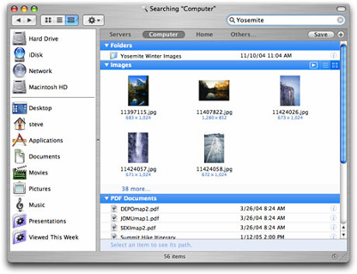
Composition
Composition is a stronger form of aggregation
Contained objects that live and die with the container
Container creates and destroys the contained objects

Slide 32
Composition vs. Aggregation
Aggregation | Composition
Part can be shared by several wholes | Part is always a part of a single whole
Parts can live independently (i.e., whole cardinality can be 0..*) | Parts exist only as part of the whole. When the wall is destroyed, they are destroyed
Whole is not solely responsible for the object | Whole is responsible and should create/destroy the objects
0..4
*
*
category
document
Window
Frame

Slide 33
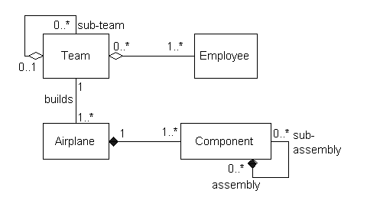
Reflexive associations

Slide 34
Notes
A note is a graphical symbol containing text and/or graphics that offer(s) some comment or detail about an element within a model.
Check with Mike
on this.
See http://www.
softdocwiz.com
See encrypt.doc

